Slide 1
The BUSINESS EDGE
Windows Graphical Interface
(UI)

Slide 2
Revolutionary Concept - Free Upgrade
No Other Distribution Software Company Does It
Most Competitors Charge Tens or Hundreds of Thousands of Dollars
No Microsoft License Fees
Very Limited Training Required (Based on the Same System)
No Loss of The BUSINESS EDGE’S Functionality
Able to use “Wire Frame” and Graphical Screens Simultaneously
Based on the Newest Technology – Graphical Technology only 4 Years Old
Technology being used by Leaders of Industry, VISA, Best Buy, etc.

Slide 3
Free Upgrade for All Clients
Many Similarities make Transition Easy
Menu Sequence the Same
Question Sequence in Data Entry Screens the Same
Partial Lookups the Same
Spacebar – Enter brings up Entire File
Recently Used List is Available Throughout the System
Yes – No Entries still Require only 1 Keystroke (1 & 2 still work)
The OK Button acts like Escape
Keyboard Entry can be used Interchangeably with Mouse
Up Arrow, Down Arrow, Page Up. Page Down Still Work
Home and End Keys Still work
Function Keys Still Used (Function Key May be Different)

Slide 4
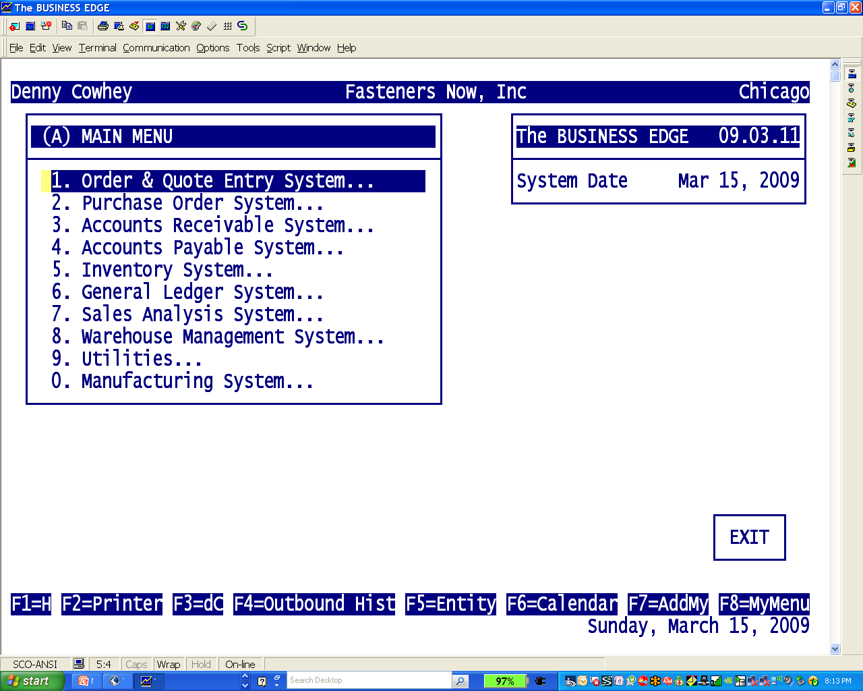
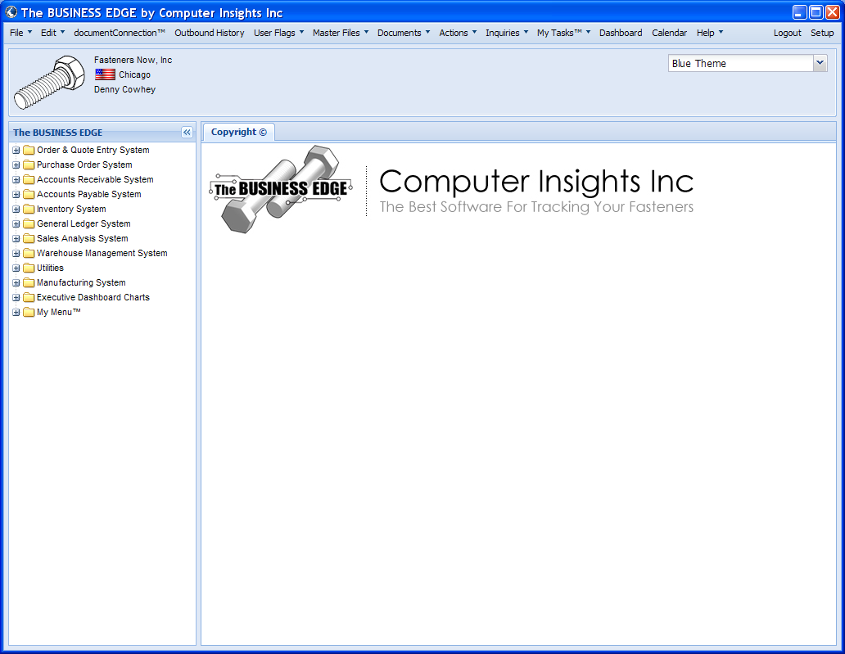
Wire Frame and Graphical
WINDOWS UI Screen
Wire Frame Screen

Slide 5
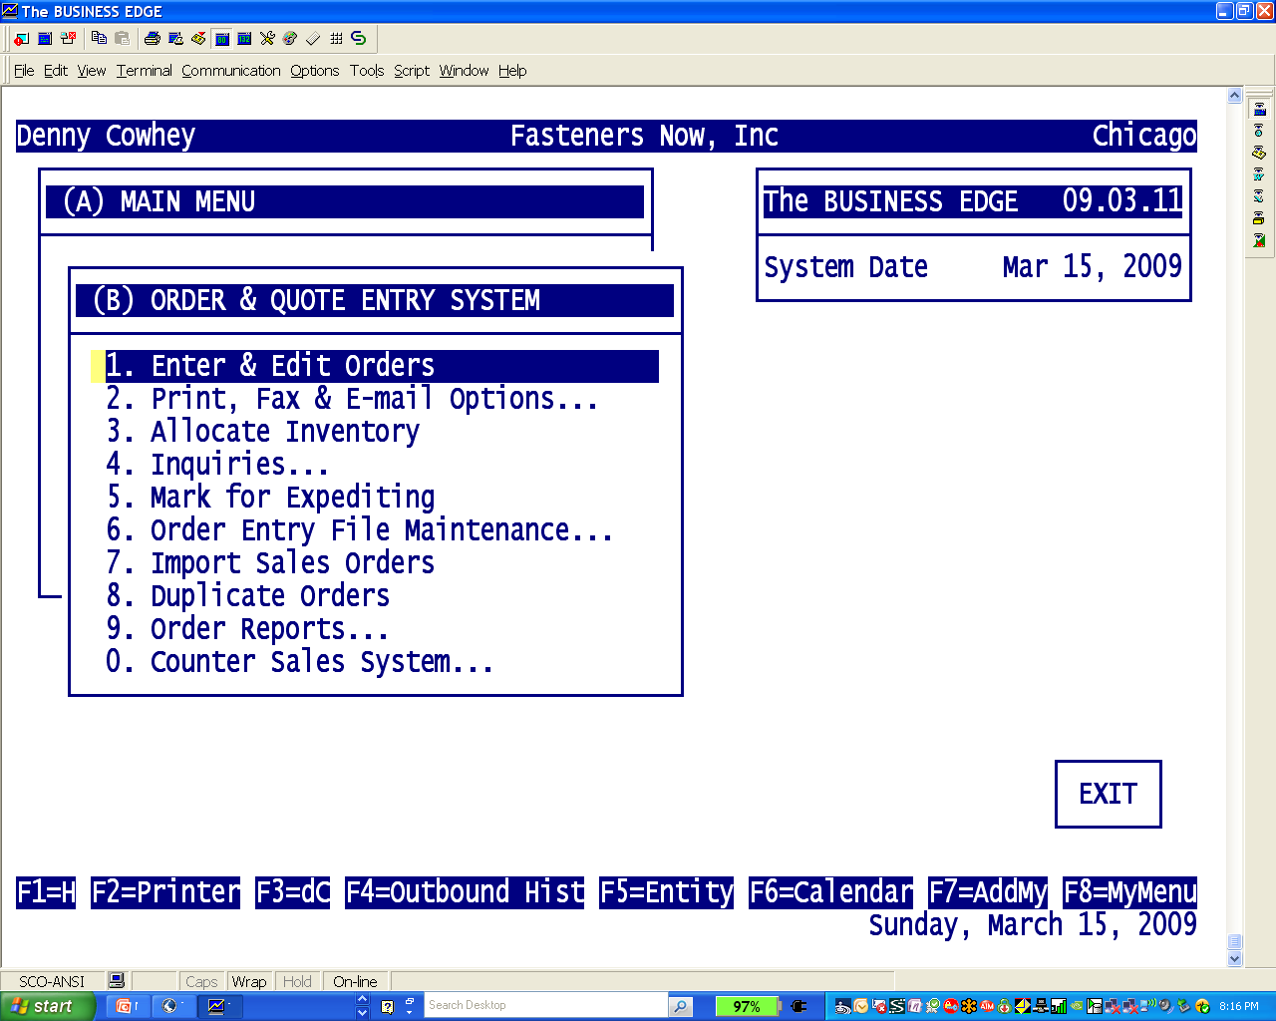
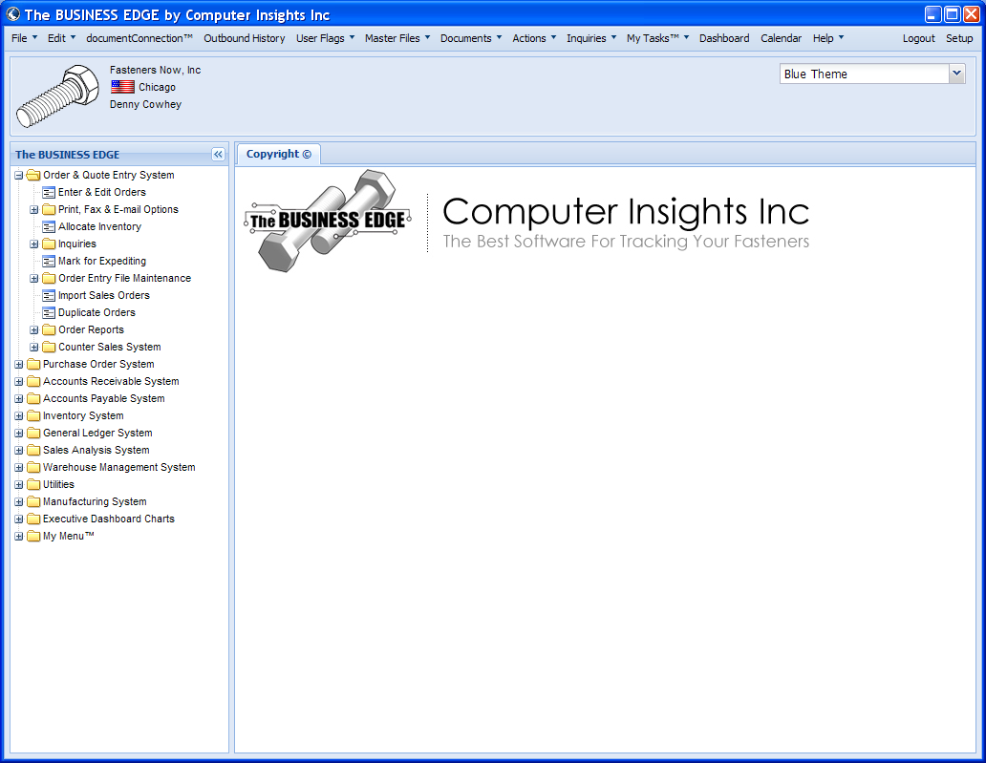
Order Entry Menu
Wire Frame Screen
WINDOWS UI Screen

Slide 6
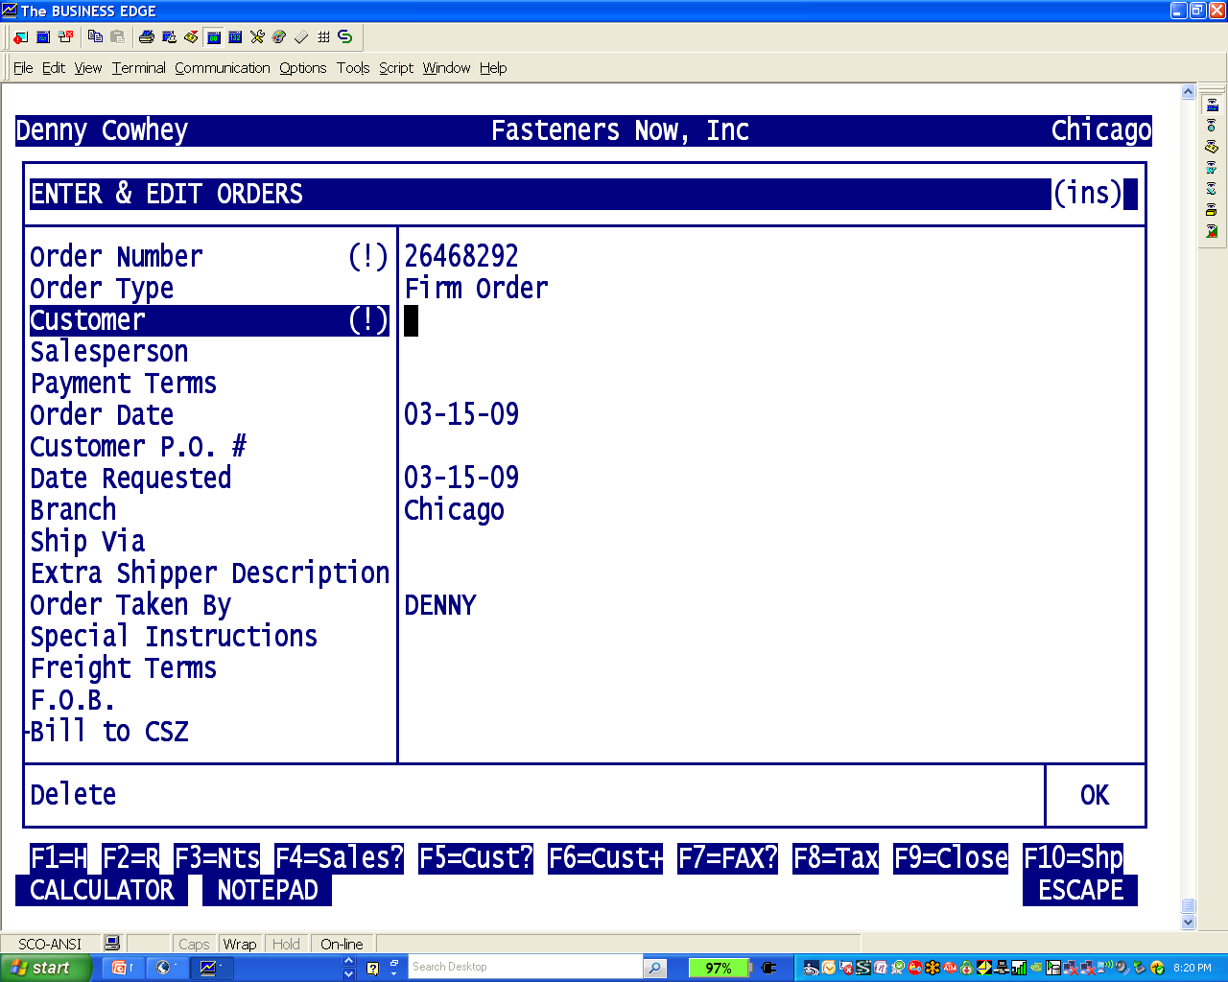
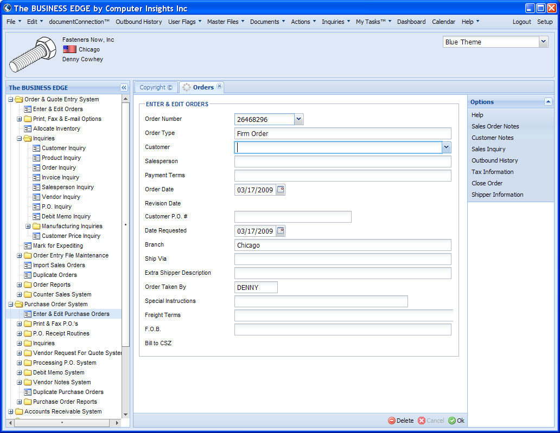
Order Entry Heading Screen
Wire Frame Screen
WINDOWS UI Screen

Slide 7
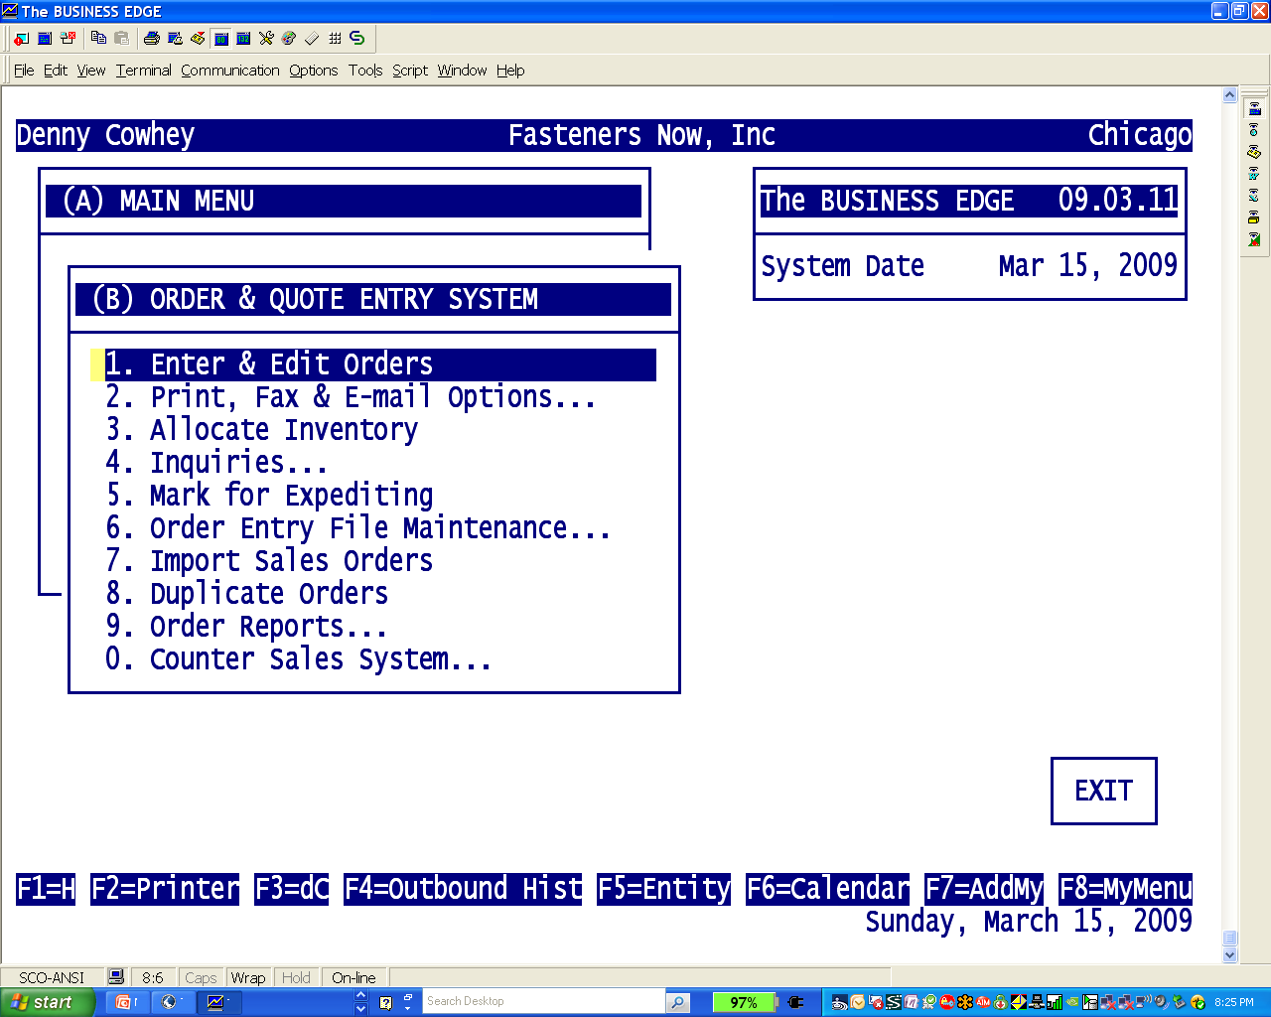
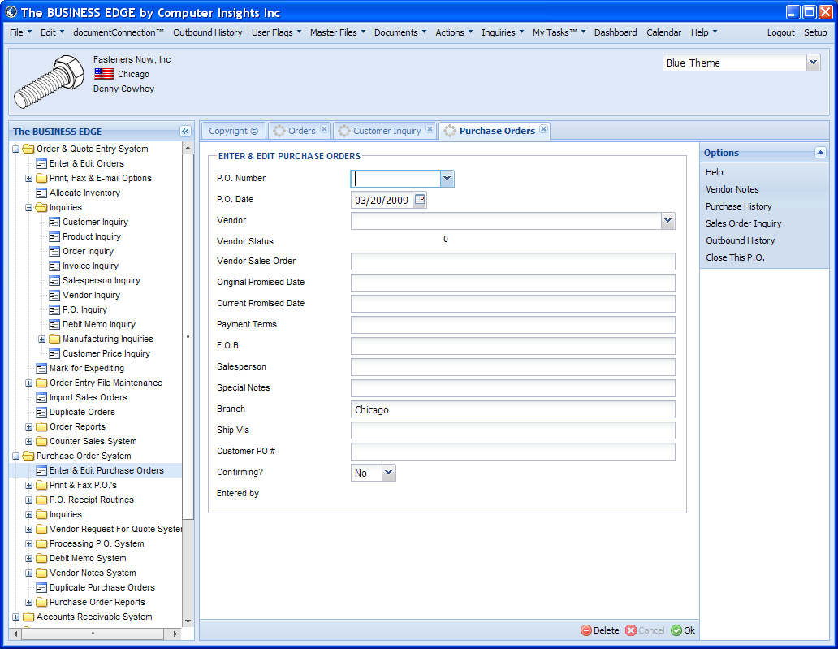
Menu Tree More Flexible
One Menu at a Time
Multiple Menus at Once

Slide 8
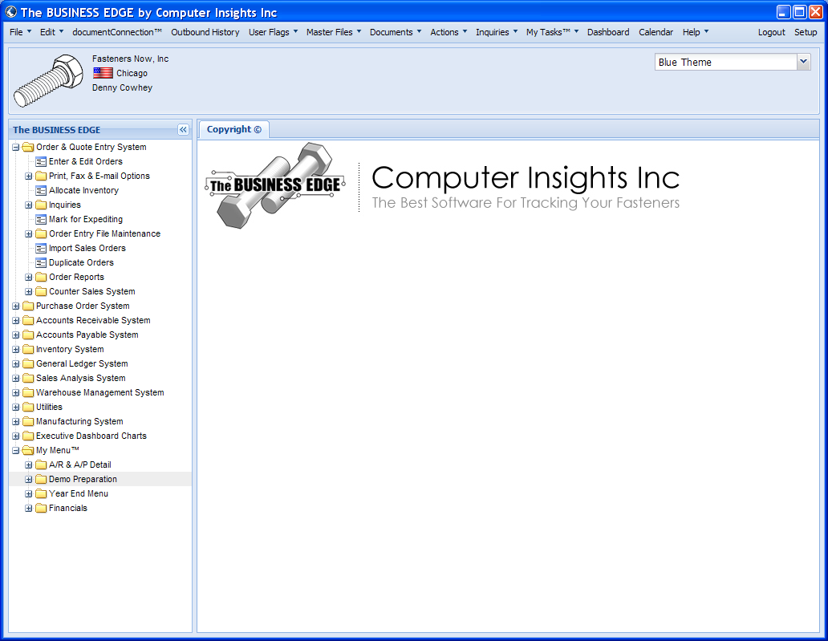
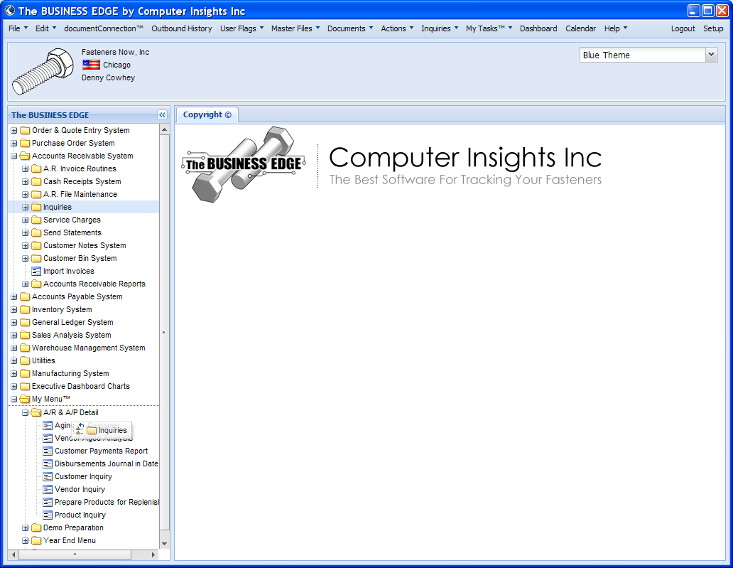
My Menu – Drag & Drop
My Menu Works as it does now
Add Items with Drag & Drop

Slide 9
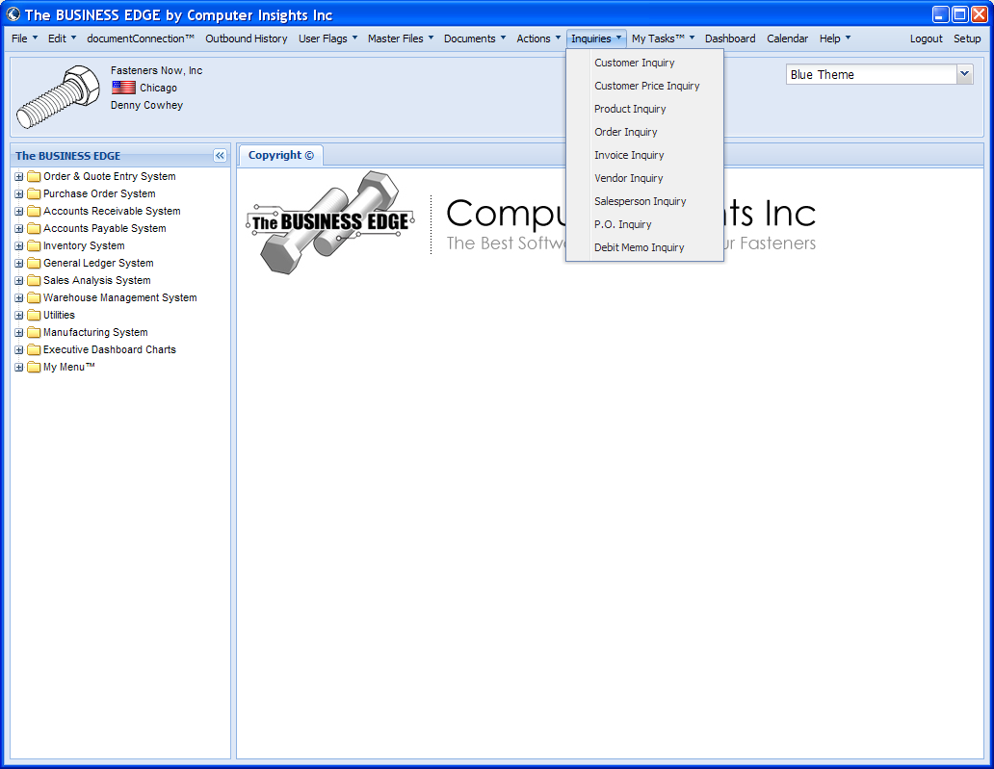
Tool Bar Enables Multi-tasking
Tool Bar Choices
Multiple Menus Can BE Open
Outbound History
User Flags
Master Files
Documents
Actions
Inquiries
My Tasks
Dashboard
Calendar
Help

Slide 10
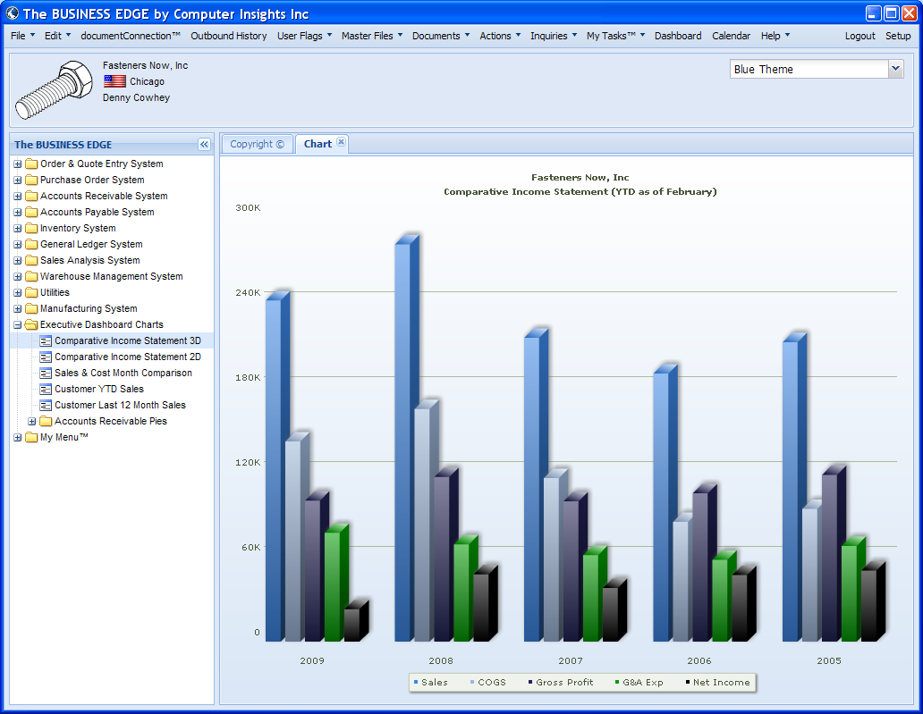
Executive Dashboard - Financials

Slide 11
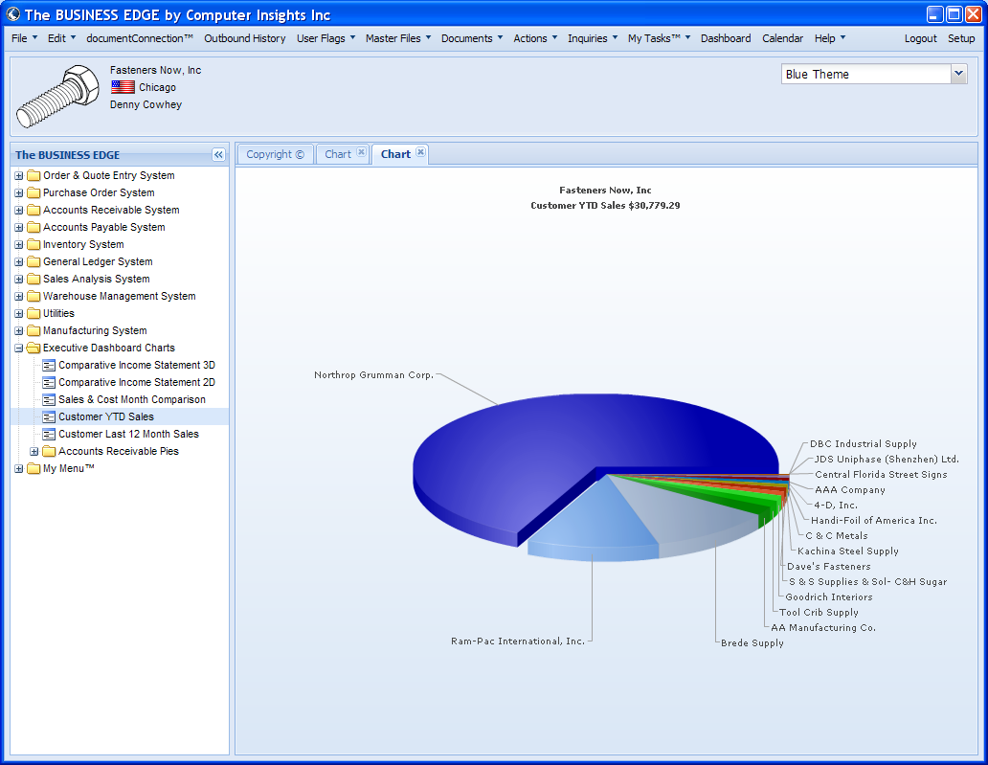
Executive Dashboard - Sales

Slide 12
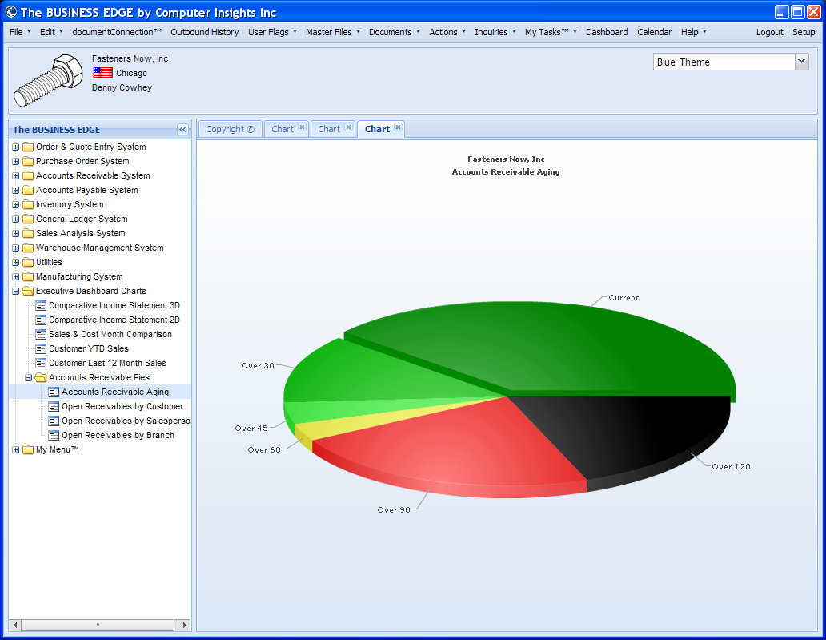
Executive Dashboard – Accounts Receivable

Slide 13
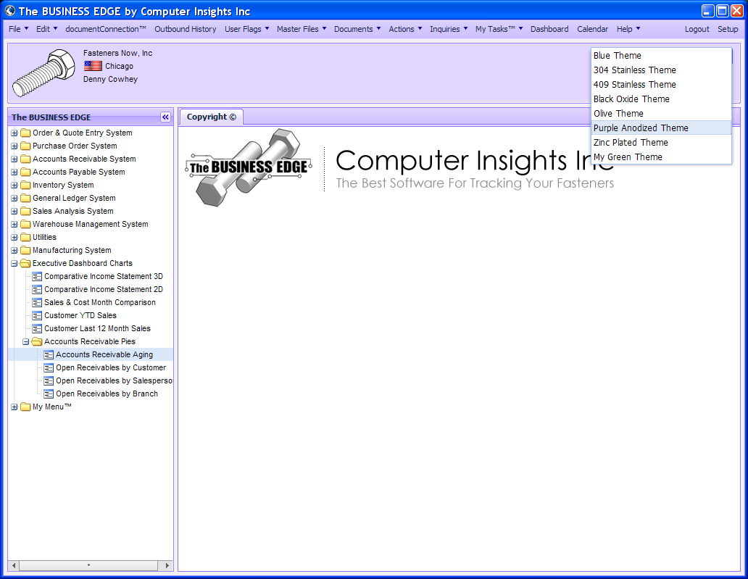
Style Sheets for Color Themes

Slide 14
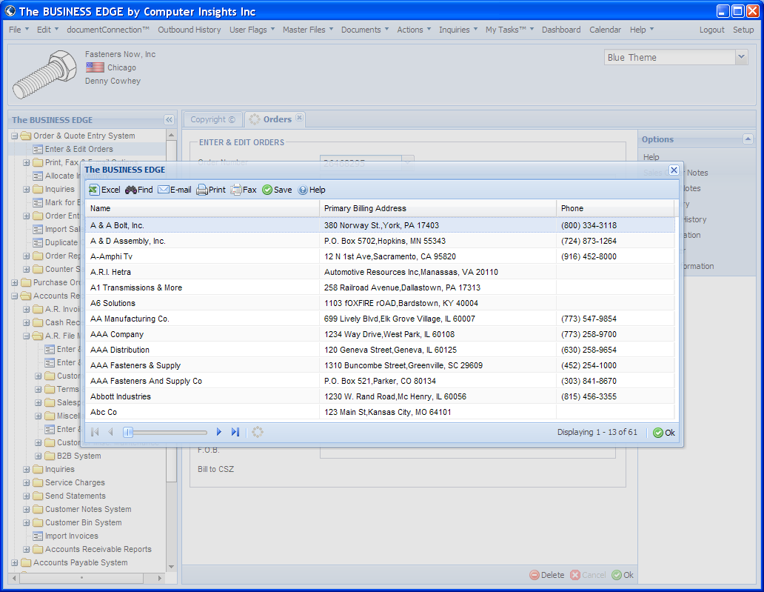
Customer Selection – Partial Lookup

Slide 15
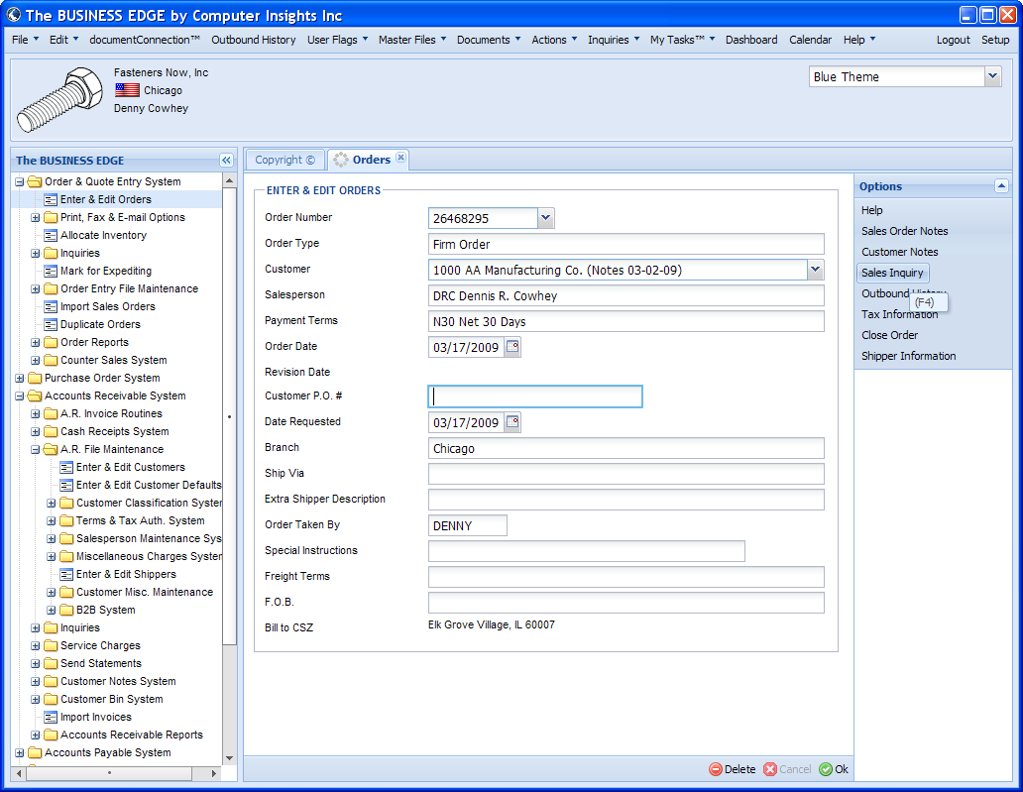
Function Keys Moved

Slide 16
Changes to Function Keys
All Occurrences of F2 (Reserved) Removed
Fkeys that called up Master Files Removed
New Tool Bar on Top makes Fkeys for Master Files Redundant
Fkeys now Displayed in Accordions on Right
Fkey Clusters make them all Available from Top

Slide 17
New Interface More Flexible
Multiple Tabs Eliminate Need for Multiple Logins
System can Remember your Login & Password
Many Activities can be Active
Provides Access to Master Files from Anywhere
Google Calendar is Included

Slide 18
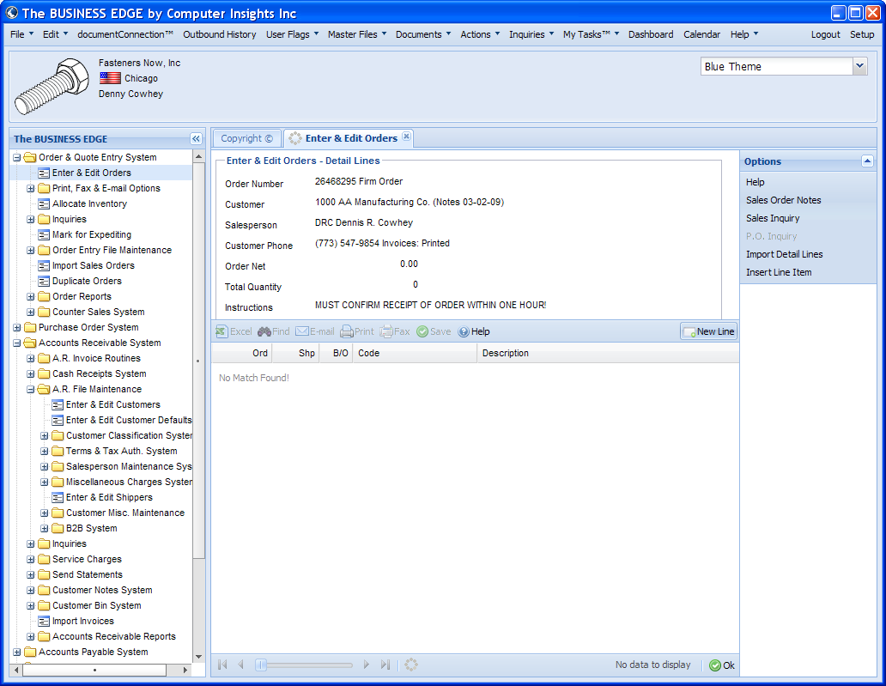
New Line Now a Button

Slide 19
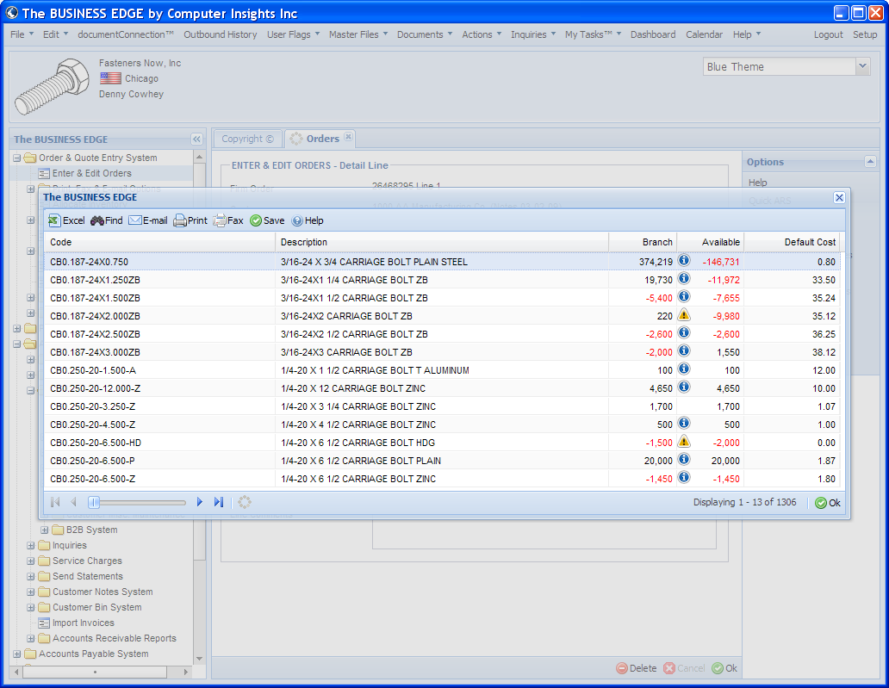
Icons Instead of Asterisks

Slide 20
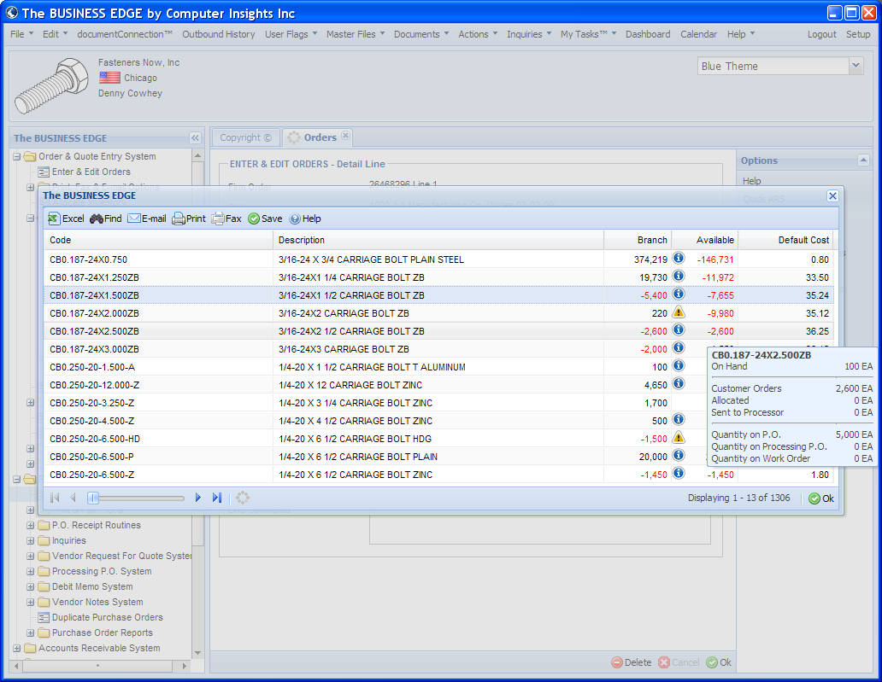
Mouse Rollover Gives More Information

Slide 21
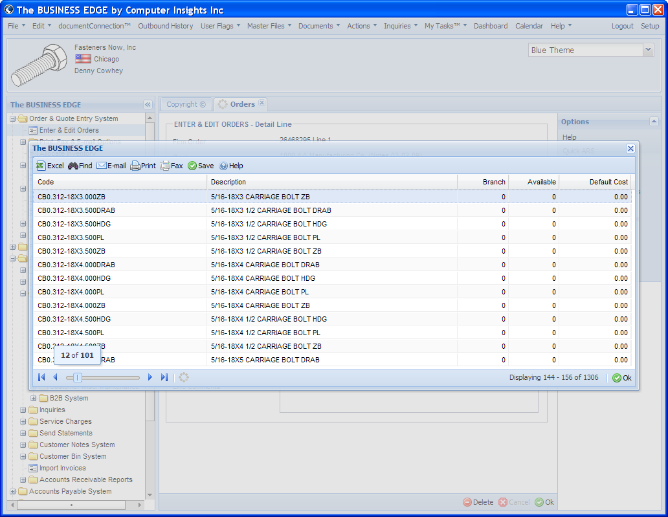
Sliding Navigation Bar for Quick Access

Slide 22
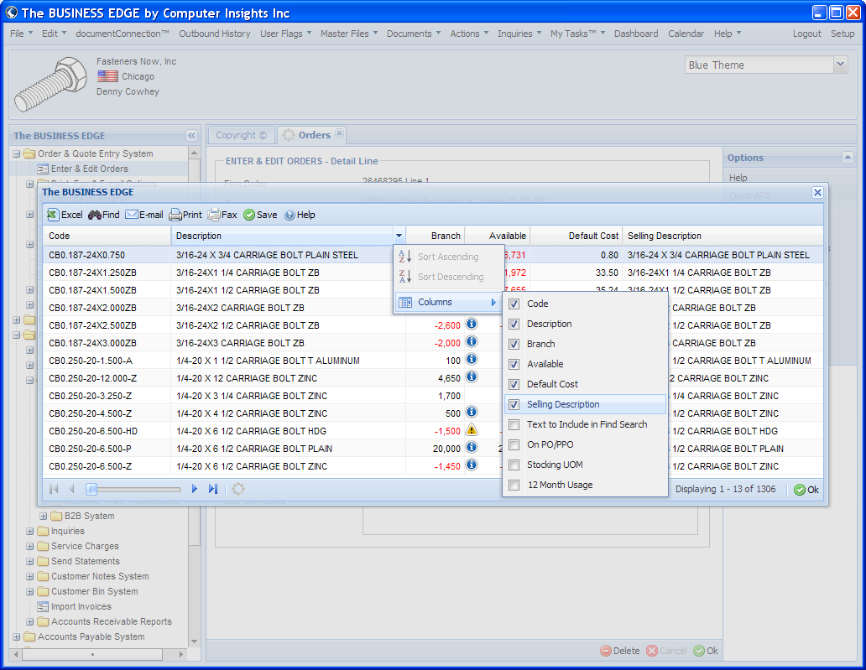
Columns can be Resized & Columns can be Added

Slide 23
System Requirements
Server must have Recent Version of TBE
Some Clients with Old Servers may have to Upgrade their Servers in order to Install the Latest Version of TBE
PC should have at least 2 GB Main Memory
PC Should have a “fast” Processor
Screen Resolution Minimum 1024 X 768
More Speed More Memory, More Pixels (and Bigger Monitor) are Good

Slide 24
Delivery Schedule
Now in Beta Testing
  Our Office
  Certain Clients
  Roll-out will be Determined by Success of Beta’s
  We have All the Functionality that we need in the new Graphical Framework
  Program Changes are going well
  No Surprises

